Slide 1
Front End Engineering-II Project
Clothing Website
TEAM DETAILS:
SHIWANGI (TEAM LEADER) 2310992210(G-25) shiwangi2210.be23@chitkara.edu.in
RAMANJOT KAUR 2310992189 (G-25) ramanjot2189.be23@chitkara.edu.in
SAHIRA 2310992199 (G-25) sahira2199.be23@chitkara.edu.in
Supervised By Batch-2023; G-25; Semester - III
Internal Faculty: Ms. Meenu Bala
External Faculty: Mr.Shivam Singh
:
Chitkara University Institute of Engineering and Technology,
Chitkara University, Punjab

Slide 2
Abstract
This project involves the development of a responsive clothing website with sections dedicated to women, men, and kids. Using HTML, CSS, Bootstrap, JavaScript, and React, the site provides a modern, user-friendly experience on any device. The structure relies on HTML5 for a solid, semantic foundation, while CSS3 enhances the visual appeal with custom styles. Bootstrap’s mobile-first grid system ensures responsive design, and JavaScript with React brings interactivity, enabling reusable components. Each section – women, men, and kids – displays a variety of clothing items, complete with images, descriptions, prices, and a user-friendly shopping cart. This responsive design delivers efficient load times and an optimal browsing experience for users. The goal is to create a seamless online shopping platform that meets diverse customer needs through the strengths of modern web technologies.

Slide 3
Table of Contents
Introduction
Problem Statement
Key Features
Code Snippets
Output
Project Github Link
Conclusion
References/Links used

Slide 4
Introduction
Background
The rise of online shopping has transformed how people shop for clothing, reshaping customer expectations.
Many consumers now prefer the ease and speed of online shopping over visiting physical stores.
Online shopping allows people to browse and purchase clothing anytime, anywhere, with access to a larger variety of products.
For clothing brands, adapting to this shift is essential to stay relevant and competitive in a digital-first market.

Slide 5
Introduction
Objectives
The project aims to develop an e-commerce platform called "Clothify" to capitalize on the online shopping trend.
Clothify’s goal is to offer a seamless and enjoyable shopping experience, catering to the needs of modern online shoppers.
Key focuses include user-friendly navigation, appealing product displays.
Clothify aims to meet the growing demand for accessible and responsive online shopping platforms.

Slide 6
Introduction
Significance
Physical clothing stores face limitations due to location, hours, and limited stock, restricting their reach and sales potential.
Clothify removes these barriers by providing 24/7 accessibility, enabling customers to shop anytime and explore a wider range of products.
The platform helps brands expand their market reach and improve customer engagement through convenience and personalization.
Clothify bridges the gap for brands, offering a seamless shopping experience across all devices to accommodate the busy lives of today’s consumers.

Slide 7
Problem Statement
With more people shopping online, there's a growing need for easy-to-use e-commerce websites.
Physical clothing stores have limits on where they can reach and their operating hours, which can result in missed sales and less customer engagement.
There’s a clear need for an online solution that helps clothing brands expand their market and offer a smooth shopping experience on any device.

Slide 8
Key Features
Following are the Key Features of Our Project:
Responsive Design
User Registration and Login Form
Product Catalog
Review Section
Product Description

Slide 9
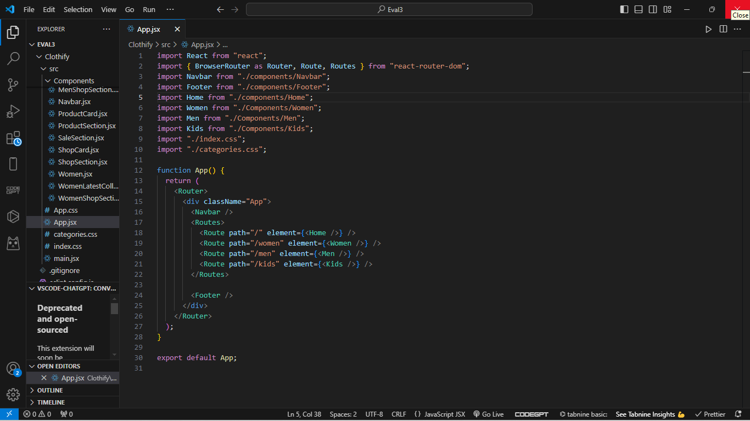
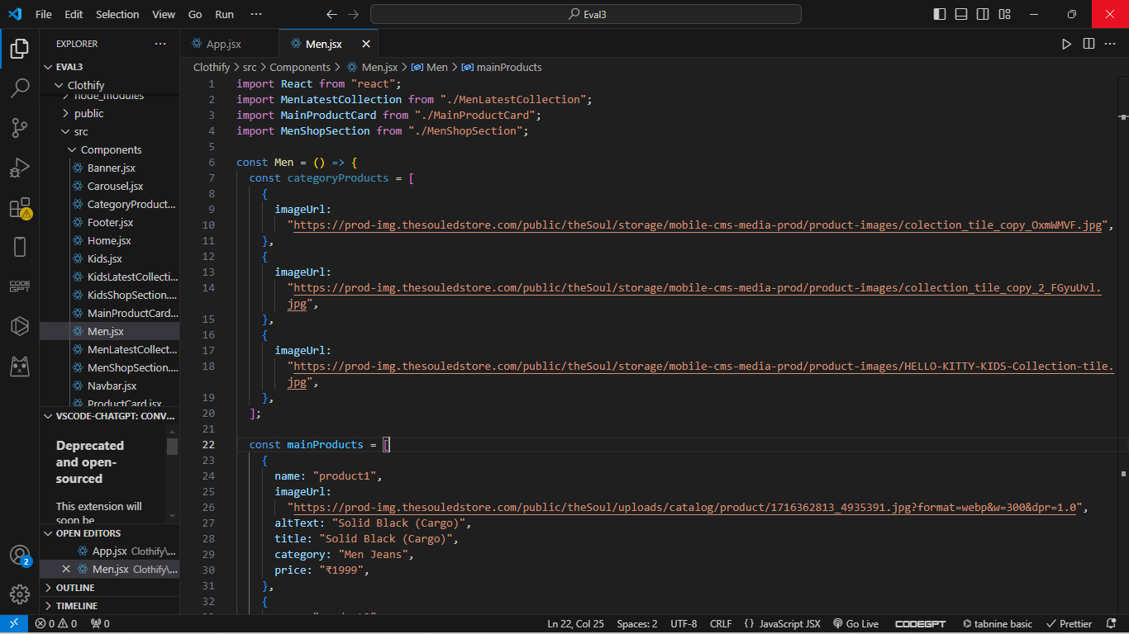
Code Snippets

Slide 10
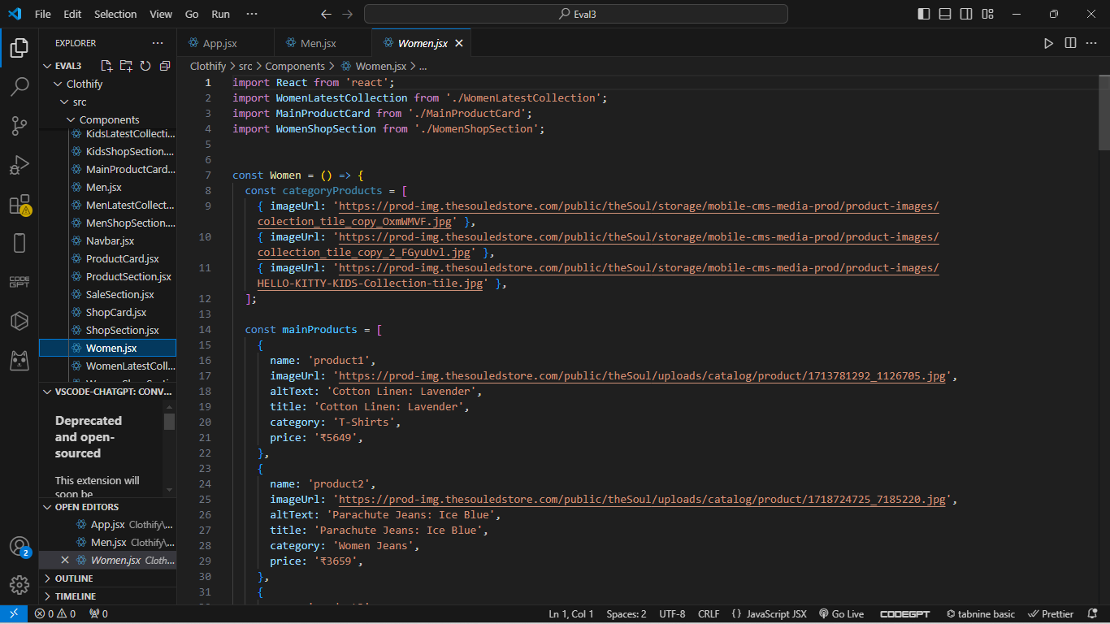
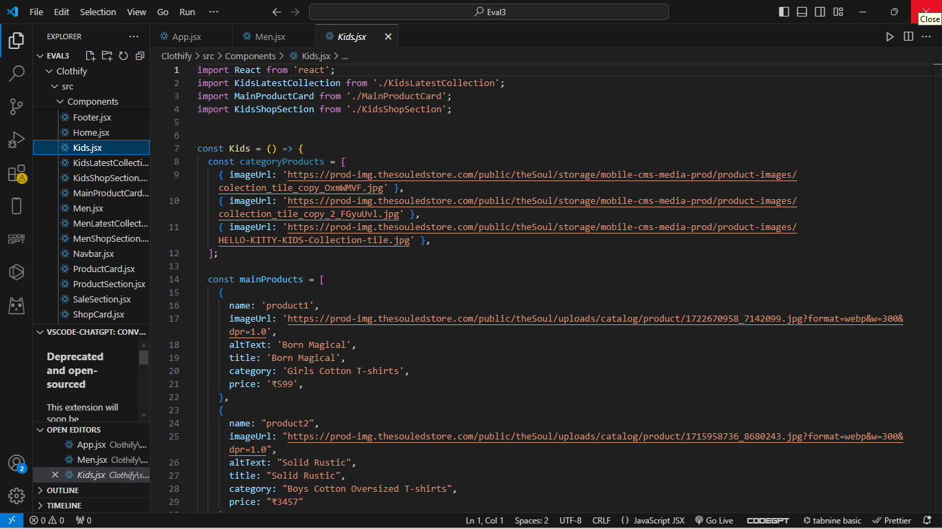
Code Snippets

Slide 11
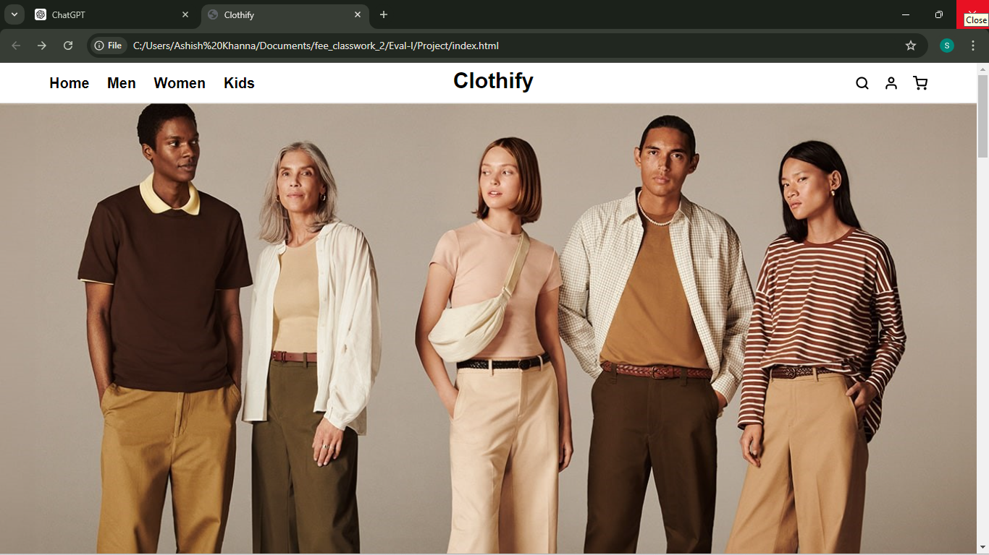
Output
HOME PAGE :

Slide 12
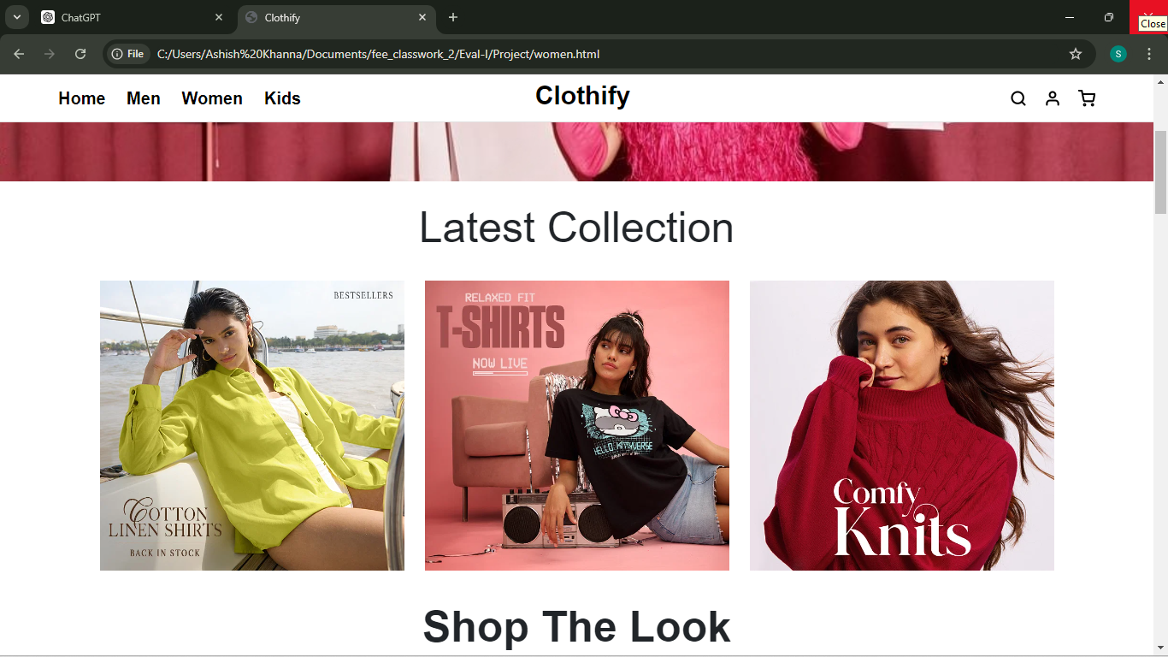
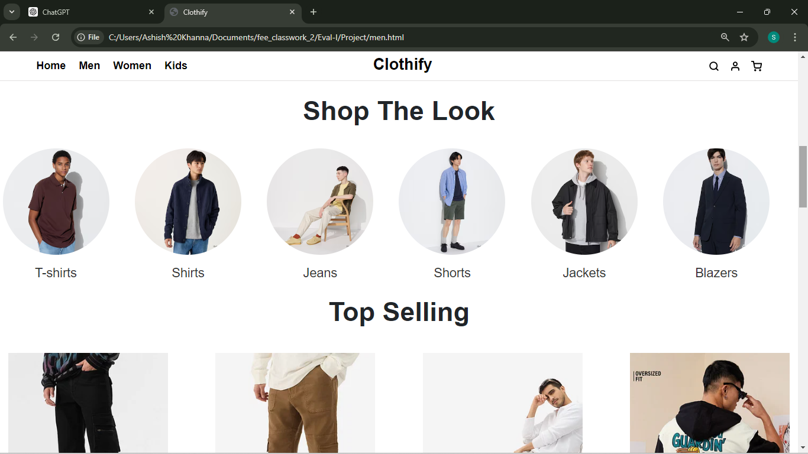
PRODUCTS SECTION :

Slide 13
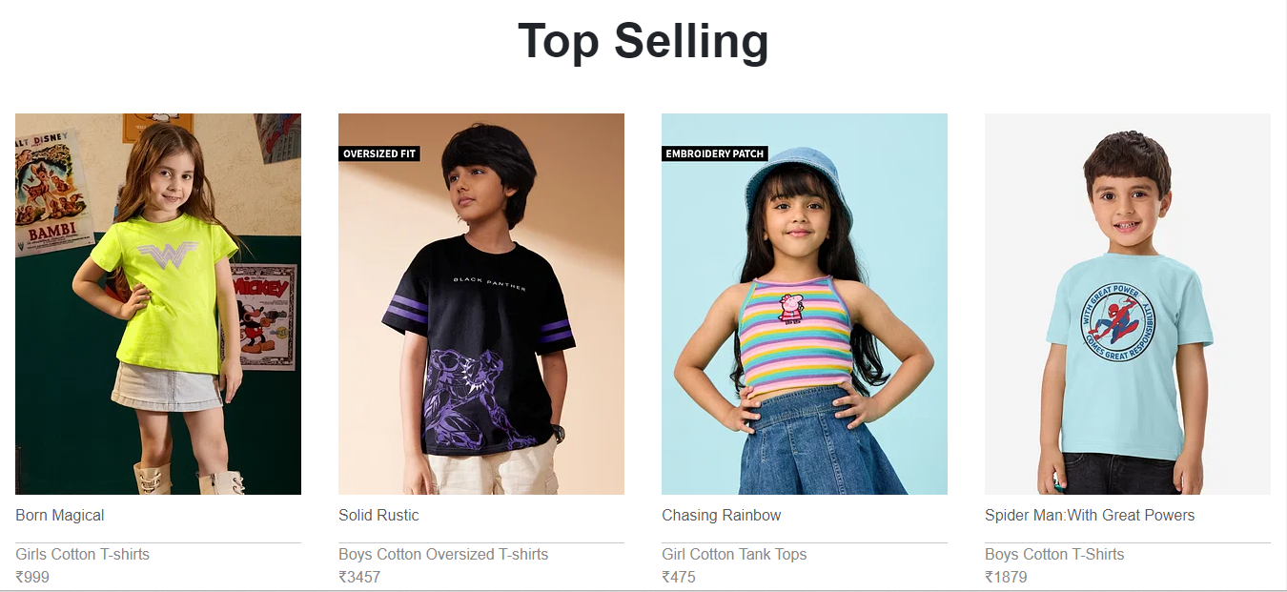

Slide 14
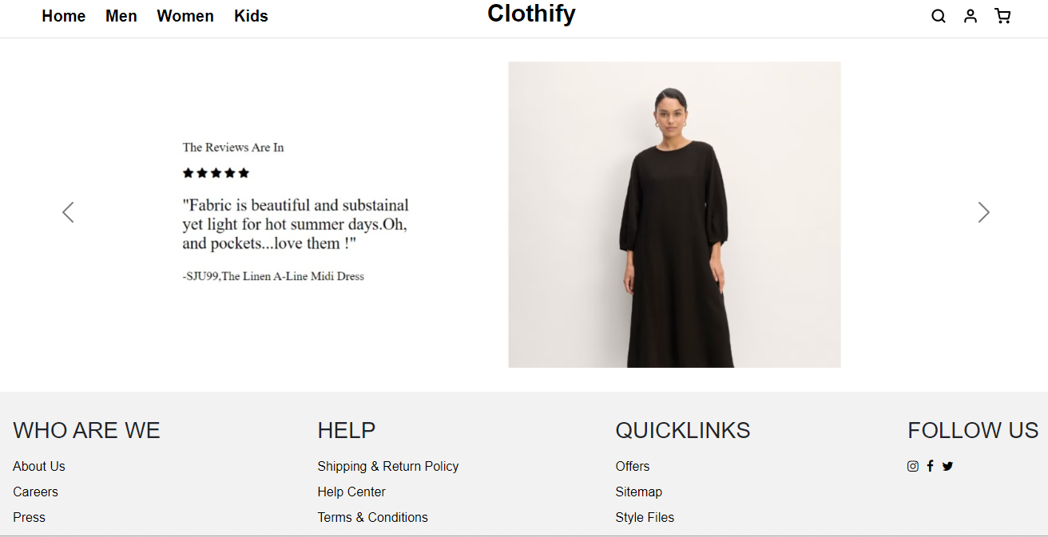
REVIEW :

Slide 15
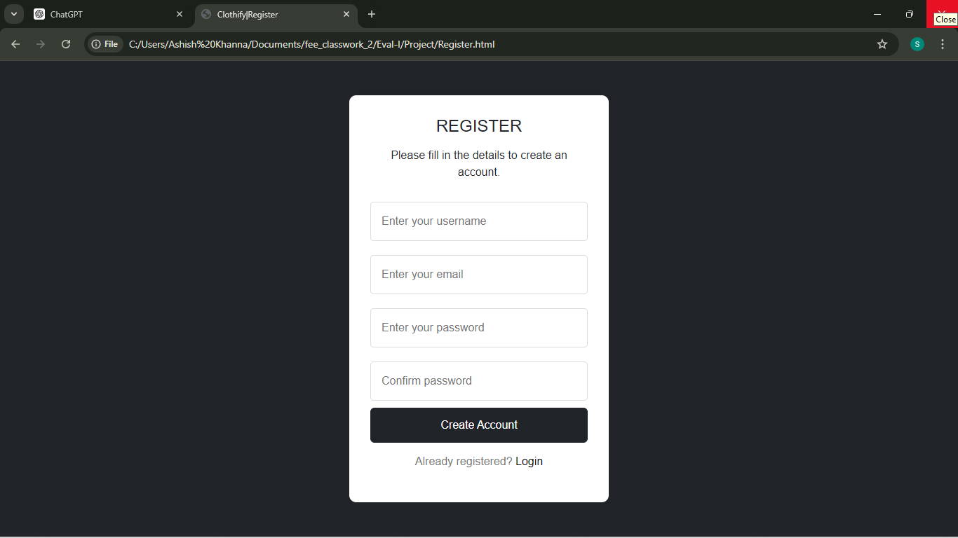
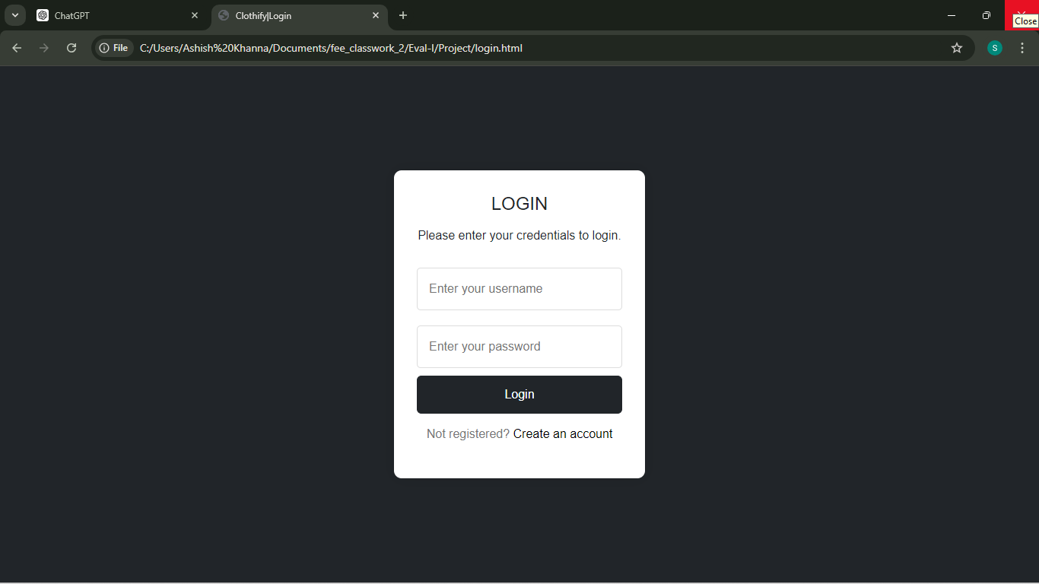
REGISTRATION AND LOGIN PAGE :

Slide 16
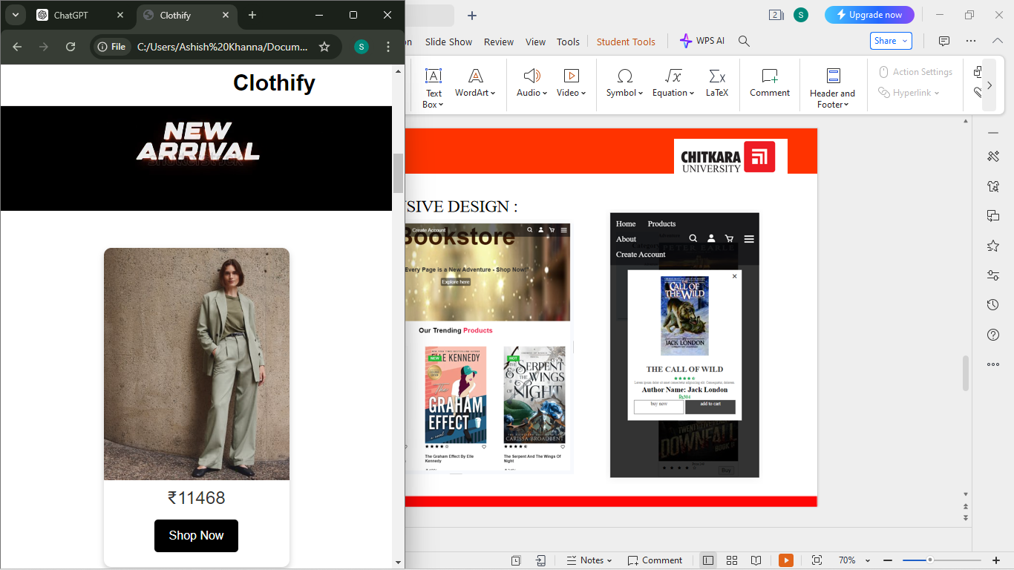
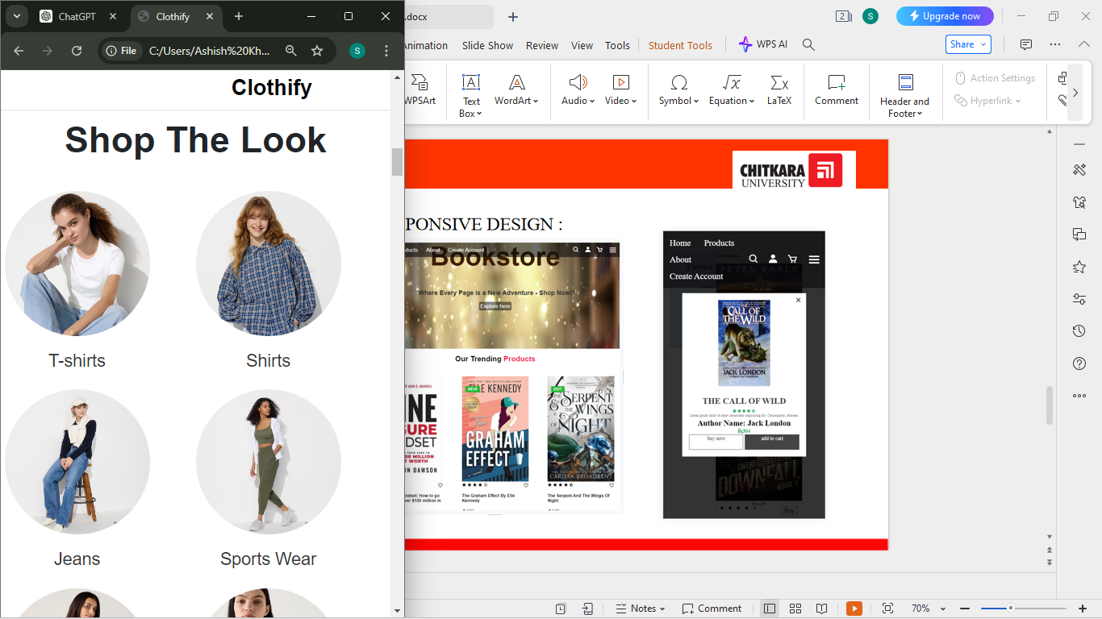
RESPONSIVE DESIGN :

Slide 17
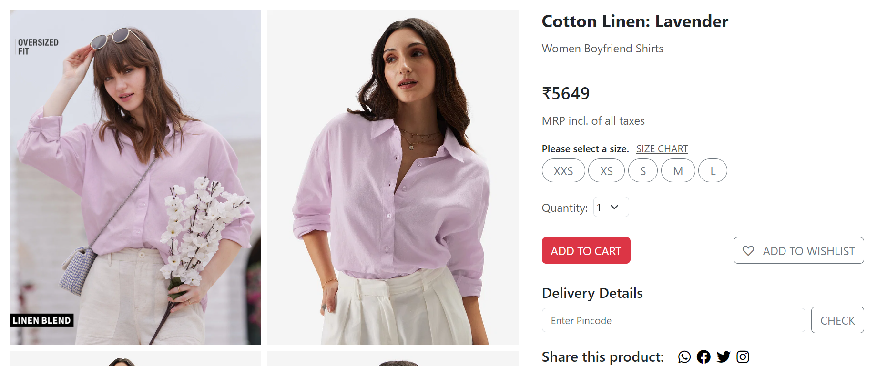
Product Description Page:

Slide 18
Project Github Link
Link: https://github.com/sahira0205/FEE_11/tree/main

Slide 19
Conclusion
In closing, "Clothify" is designed to be more than just a clothing website. It’s a space where fashion enthusiasts can easily explore the latest trends and styles. Our goal was to create a website that is both user-friendly and enjoyable, making your experience smooth and engaging.
With features like a clear product catalog, user-friendly registration and login forms, and a review section, "Clothify" is set up to help you find and enjoy clothing with ease.
Thank you for visiting "Clothify." We hope you enjoy discovering new fashion finds and look forward to continuing to improve your experience in the future.

Slide 20
References
https://www.everlane.com/
https://thesusoutdoors.com/
https://www.zara.com/
https://www2.hm.com/en_in/index.html

